Slide 1
Implementing a Pet Waste Disposal Program to Protect Anne Arundel County
Michael Sullivan Purdue University Global CM 220: College Composition II Professor Eric Lane October 22, 2024

Slide 2
Introduction to Pet Waste and Pollution in Anne Arundel County
In Anne Arundel County, stormwater pollution is directly worsened by improper disposal of pet waste. Left on the ground, pet waste is carried by rainwater into local water systems, transporting with it harmful bacteria, parasites, and nutrients that degrade our water quality. The direct environmental impacts of that degradation such as algal blooms and oxygen-poor waters are bad enough. But the real kicker comes when you consider the public health and economic threats posed by stormwater pollution. Polluted waters with public health risks don't bode well for any water-dependent business, including Maryland's seafood industry, which hasn't escaped the significant economic downturn that polluted waterways bring.
This presentation is intended to promote the idea of a community pet waste disposal program, which would greatly lessen the impact of storm runoff pollution in our town. It would also make our community healthier and safeguard our local environment and economy.

Slide 3
Thesis Statement
A thorough pet waste disposal program, administered by the Department of Public Works in Anne Arundel County, will lessen the financial burden caused by contaminated stormwater, protect the health of the people, local businesses, and recreational users, and preserve the aquatic ecosystems that are part of our community’s heritage.

Slide 4
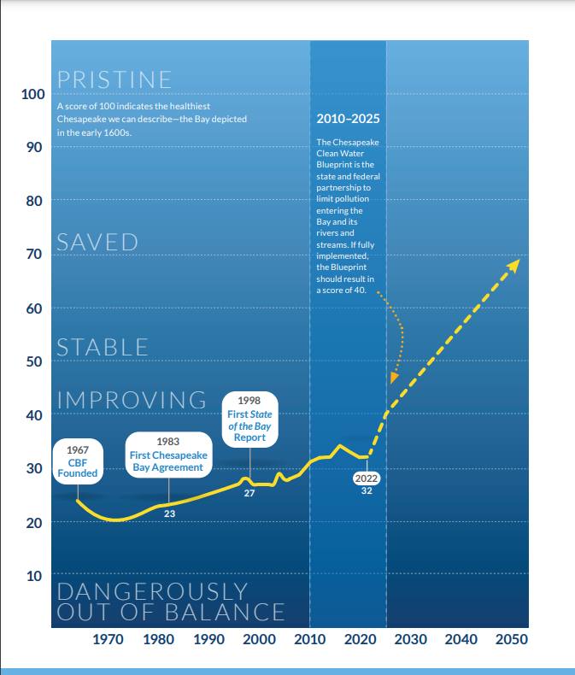
The Impact of Pet Waste on Stormwater Pollution
Pet Waste as a Pollutant: Pet waste washed into stormwater systems during rain carries harmful bacteria contaminating local water supplies.
Nutrient Pollution and Ecosystem Damage: Pet waste contains nutrients like nitrogen and phosphorus, which fuel algal blooms. These deplete oxygen in the water, harming aquatic life and disrupting ecosystems.

Slide 5
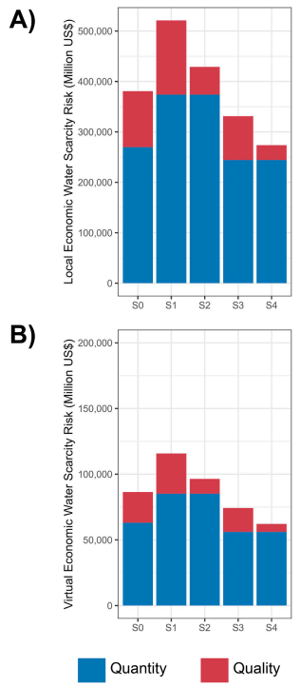
Economic and Environmental Impact
Economic Losses: Improper pet waste disposal has significantly impacted Maryland’s seafood industry, contributing to a $500 million loss over the past 10 years due to water pollution. Clean water is vital for businesses like fishing, tourism, and recreation.
Public Health Risks: Bacterial contamination from pet waste, including harmful pathogens like E. coli and Salmonella, poses serious public health risks, affecting both drinking water and recreational areas.

Slide 6
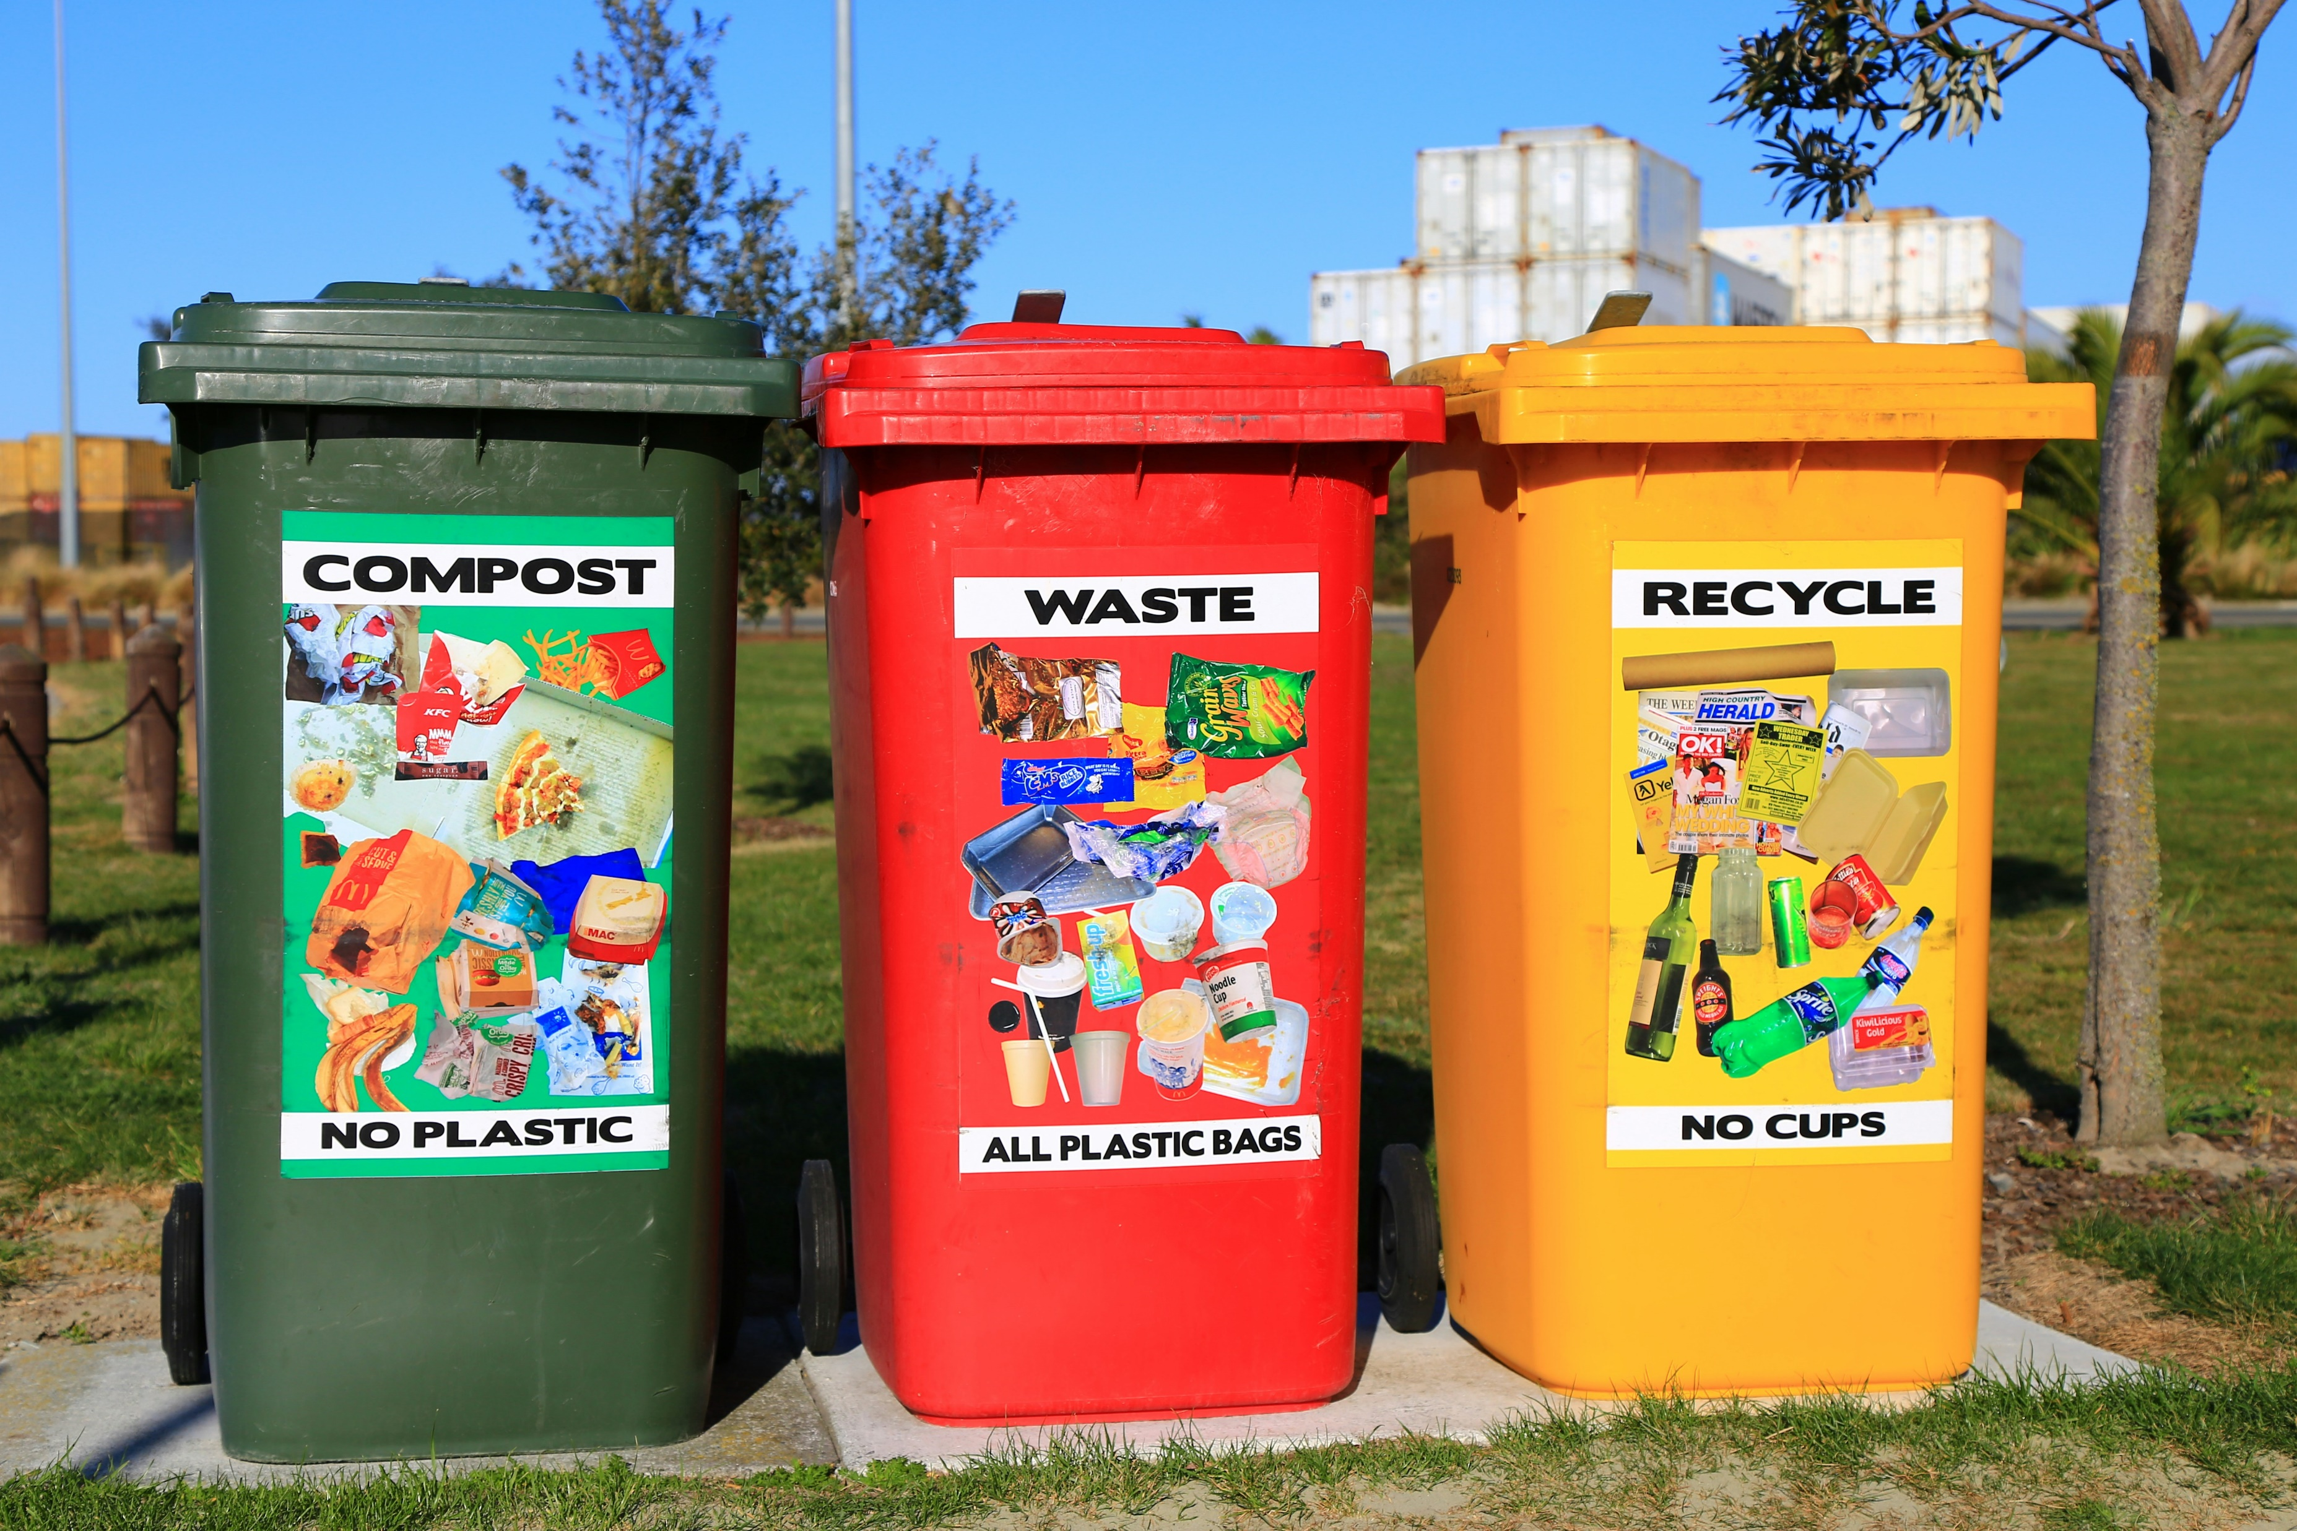
Proposed Pet Waste Disposal Program for Anne Arundel County
Responsibilities of the Department of Public Works: The Department of Public Works will lead the program. Public works employees will install and maintain the pet waste stations. They will work in public spaces, ensuring both station installation and waste collection in those areas, while also providing public awareness campaigns.
Community-Driven Solutions: The program will also encourage community involvement through initiatives such as:
Composting Programs: Local composting facilities can safely process pet waste, reducing landfill use.
Localized Collection Points: Neighborhood collection stations will make it easy for residents to dispose of pet waste properly, helping reduce stormwater pollution.

Slide 7
Addressing Cost and Efficiency Concerns
Cost Concerns: Critics argue that pet waste programs are too costly and strain local budgets.
Inefficiency Concerns: Some suggest centralized systems are less efficient and do not fully engage communities.
Hybrid Solution: A combination of centralized management and community-driven efforts, like localized collection points and composting, can reduce costs and improve efficiency.
Support: Seldman & Morris (2020) advocate for decentralized systems as more cost-effective and sustainable. This hybrid approach balances both concerns.

Slide 8
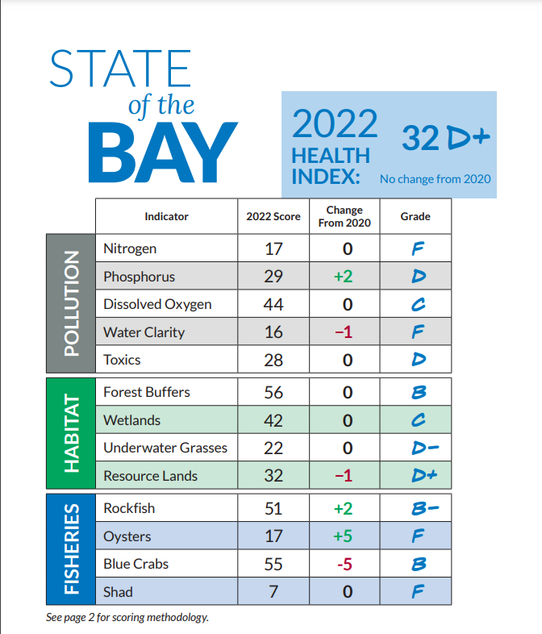
Support the Pet Waste Disposal Program
Take Action for Cleaner Waterways: By supporting this pet waste disposal program, you help reduce pollution, protect public health, and preserve our natural environment.
Reduced Stormwater Management Costs: This program, if implemented, will save money in the long term on stormwater management, to the benefit of our community and local businesses.
Your Role Matters: Together, we can make a difference. Join us in keeping our waters clean and ensuring a healthier future for all.
Together, we can preserve our environment and protect our health one step at a time.

Slide 9
Summary
The Need for Action: Pet waste pollution is a serious issue affecting our waterways, health, and local economy. A pet waste disposal program is essential for addressing this problem.
Favorable Results: Everyone in the community will reap the rewards of cleaner water, healthier ecosystems, minimized public health risks, and major savings in managing stormwater.
Final Call to Action: The opportunity to take action has arrived. It is now necessary to work in collaboration to put this program into effect. Together, we can remold the future of this community, making it cleaner and healthier for its residents.

Slide 10
References
Anne Arundel County Department of Public Works. (2013). Ten-year solid waste management plan 2013-2023. https://www.aacounty.org/sites/default/files/2023-03/SWMP.pdf
Chesapeake Bay Foundation. (2022). 2022 State of the Bay Report. https://www.cbf.org/document-library/cbf-reports/sotb/2022-state-of-the-bay-report.pdf
District of Columbia Department of Energy & Environment. (2024). Pet waste. https://doee.dc.gov/page/petwaste
New Hampshire Department of Environmental Services. (2024). Pet health and the environment. https://www.des.nh.gov/home-and-recreation/your-health-and-environment/pet-health-and-environment
Seldman, N., & Morris, D. (2020, July). Fighting monopoly power: Recycling and waste. Institute for Local Self-Reliance. https://ilsr.org/fighting-monopoly-power/recycling-waste/

Slide 11
References Continued (Images/Graphs)
Chesapeake Bay Foundation. (2022). Nitrogen and phosphorus pollution overview [Photograph]. https://www.cbf.org/document-library/cbf-reports/sotb/2022-state-of-the-bay-report.pdf
Chesapeake Bay Foundation. (2022). State of the Bay score chart [Photograph]. https://www.cbf.org/document-library/cbf-reports/sotb/2022-state-of-the-bay-report.pdf
Martin, N. (n.d.). Red, yellow, and green trash bins [Photograph]. Unsplash. https://unsplash.com/photos/red-yellow-and-green-trash-bins-FoG7PKNYjpM
Yang, J., Li, J., van Vliet, M. T. H., Jones, E. R., Huang, Z., Liu, M., & Bi, J. (2024). Local and virtual economic water scarcity risk [Graph]. Water Research, 252, 121216. https://doi.org/10.1016/j.watres.2024.121216

